Slide 1
CSE 430: Software Quality Assurance and Testing

Slide 2
Lecture 01

Slide 3
What is Software?
IEEE definition
Software is Computer programs, procedures, and possibly associated documentation and data pertaining to the operation of a computer system.

Slide 4
Quality
The American Heritage Dictionary defines quality as
“a characteristic or attribute of something.”

Slide 5
bad software plagues nearly every organization that uses computers, causing lost work hours during computer downtime, lost or corrupted data, missed sales opportunities, high IT support and maintenance costs, and low customer satisfaction
ComputerWorld in 2005

Slide 6
“the sorry state of software quality” reporting that the quality problem had not gotten any better
InfoWorld in 2006

Slide 7
Software Quality
Today, software quality remains an issue, but who is to blame?
Customers blame developers, arguing that sloppy practices lead to low-quality software.
Developers blame customers (and other stakeholders), arguing that irrational delivery dates and a continuing stream of changes force them to deliver software before it has been fully validated.

Slide 8
What Experts say about Quality?
Two dominant views on software quality:
Conformance and degree of satisfaction to defined specification.
The products or services capability to meet customer expectations – explicitly or implicitly stated.

Slide 9
Software Quality
For software, two kinds of quality may be encountered:
Quality of design encompasses requirements, specifications, and the design of the system.
Quality of conformance is an issue focused primarily on implementation.
User satisfaction = compliant product + good quality + delivery within budget and schedule

Slide 10
Software Quality
Software quality can be defined as:
An effective software process applied in a manner that creates a useful product that provides measurable value for those who produce it and those who use it.

Slide 11
Software Quality
IEEE definition
The degree to which a system, component, or process meets specified requirements.
The degree to which a system, component, or process meets customer or user needs or expectations

Slide 12
SQ Pressman’s Definition
Software quality– Pressman’s definition
Conformance to explicitly stated functional and performance requirements, explicitly documented development standards, and implicit characteristics that are expected of all professionally developed software

Slide 13
What is Software Quality?
What is `good' software?
What is `bad' software?
It is a Matter of Perspective

Slide 14
It is a Matter of Perspective
Your role relative to the software changes what is important to you.
End Users
Does the software have all desired features?
Can it reliably produce correct results for good input?
Does it securely & gracefully handle bad input?
Is it easy to use?
Is it responsive?
Does it integrate well with other software?
What are the consequences of missing these goals?

Slide 15
It is a Matter of Perspective
Operational / Deployment
Is the software secure from attacks that may compromise the IT infrastructure?
Does the software appropriately use resources? (CPU, Memory, Disk Space, Bandwidth, ...)
What are the consequences of missing these goals?

Slide 16
It is a Matter of Perspective
Developers
How easy is the software to adapt to changes in requirements?
Can the software be easily adapted to other systems?
How easy is the software to inspect and understand?
Can components be easily examined gauged for quality?
What are the consequences of missing these goals?

Slide 17
Software Quality Assurance
IEEE Definition
A planned and systematic pattern of all actions necessary to provide adequate confidence that an item or product conforms to established technical requirements.
A set of activities designed to evaluate the process by which the products are developed or manufactured. Contrast with quality control.

Slide 18
Software Quality Assurance (cont.)
SQA – expanded definition
A systematic, planed set of actions necessary to provide adequate confidence that the software development process or the maintenance process of the software system product conforms to established functional technical requirements as well as with the managerial requirements of keeping the schedule and operating within budgetary confines

Slide 19
The objectives of SQA activities
Software development (process-oriented):
Assuring an acceptable level of confidence that the software will conform to functional technical requirements.
Assuring an acceptable level of confidence that the software will conform to managerial scheduling and budgetary requirements.
Initiating and managing of activities for the improvement and greater efficiency of software development and SQA activities.

Slide 20
The objectives of SQA activities
Software maintenance (product-oriented):
Assuring with an acceptable level of confidence that the software maintenance activities will conform to the functional technical requirements.
Assuring with an acceptable level of confidence that the software maintenance activities will conform to managerial scheduling and budgetary requirements.
Initiating and managing activities to improve and increase the efficiency of software maintenance and SQA activities

Slide 21
Quality Control versus SQA
Quality Assurance is process oriented and focuses on defect prevention
Quality control is product oriented and focuses on defect identification.
Quality Assurance (QA) is meant to minimize the costs of quality by introducing a variety of activities throughout the development process and maintenance process in order to prevent the causes of errors, detect them, and correct them in the early stages of the development.
As a result, quality assurance substantially reduces the rate of non-qualifying products

Slide 22
Quality Control versus SQA
Quality Assurance (QA) is meant to minimize the costs of quality by introducing a variety of activities throughout the development process and maintenance process in order to prevent the causes of errors, detect them, and correct them in the early stages of the development.
As a result, quality assurance substantially reduces the rate of non-qualifying products

Slide 23
QA vs. QC
Quality Control
Quality Assurance
Quality Control makes sure the results of what we’ve done are what we expected.
QC focuses on testing for quality and hence detecting defects.
QC deals with product.
QC is for testing part in SDLC.
QC is corrective process.
Quality Assurance makes sure that we are doing the right things, the right Way.
QA focuses on building in quality and hence preventing defects.
QA deals with process.
QA is for entire life cycle.
QA is preventive process.

Slide 24
Errors, Faults and Failures
Software errors are sections of the code that are partially or totally incorrect as a result of a grammatical, logical or other mistake made by a systems analyst, a programmer, or another member of the software development team.

Slide 25
Errors, Faults and Failures
Software faults are software errors that cause the incorrect functioning of the software during a specific application.

Slide 26
Errors, Faults and Failures
Software faults become software failures only when they are “activated”, that is, when a user tries to apply the specific software section that is faulty. Thus, the root of any software failure is a software error.

Slide 27
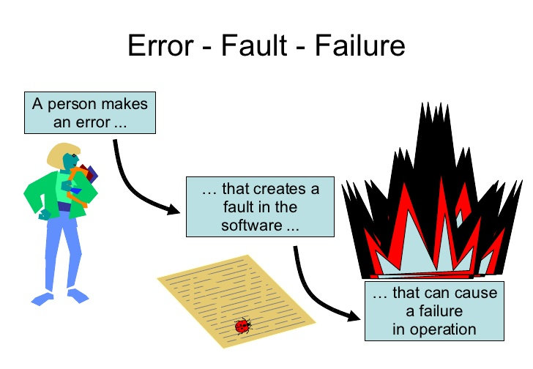

Slide 28
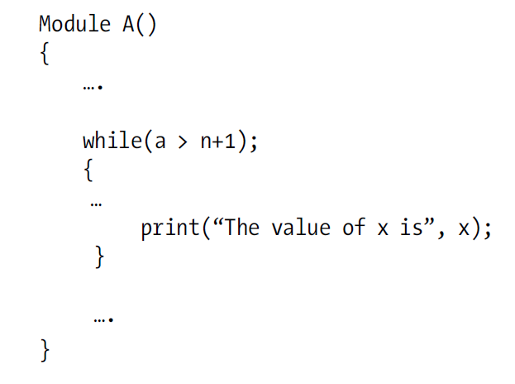
Example

Slide 29
Causes of Software Error
Faulty definition of requirements

Slide 30
Causes of Software Error
Client–developer communication failures
Misunderstanding requirement, change, design,…,etc.
Deliberate deviations from software requirements
The developer reuses software modules taken from an earlier project without sufficient analysis of the changes and adaptations needed to correctly fulfill all the new requirements.
Due to time or budget pressures, the developer decides to omit part of the required functions in an attempt to cope with these pressures

Slide 31
Causes of Software Error
Logical design error

Slide 32
Causes of Software Error
Coding error
Non-compliance with documentation and coding instructions.
Document standard.
Coding standard.

Slide 33
Causes of Software Error
Shortcomings of the testing process
Incomplete test plans leave untreated portions of the software or the application functions and states of the system.
Failures to document and report detected errors and faults.
Failure to promptly correct detected software faults as a result of in appropriate indications of the reasons for the fault.
Incomplete correction of detected errors due to negligence or time pressures.

Slide 34
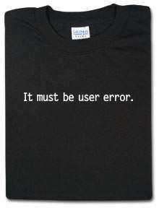
Causes of Software Error
Procedure errors :User error
Documentation errors
Omission of software functions.
Errors in the explanations and instructions given to users, resulting in “dead ends” or incorrect applications.
Listing of non-existing software functions, that is, functions planned in the early stages of development but later dropped, and functions that were active in previous versions of the software but cancelled in the current version.

